Slide 1

Bienvenidos Perry HS
Spanish Classes offered at Perry
Myths and Facts
Culture
Spanish Teachers

Slide 2
Spanish courses at Perry High School
Spanish 1- introduction to the Spanish language and culture.
Spanish 2- continuance of the Spanish language and culture, with an emphasis on grammar.
Honors Spanish 3 - increase in reading, listening, and writing skills, with an emphasis on speaking. Preparation for Advanced Placement curriculum. Dual Credit (Span 101-102) through Chandler Gilbert Community College
AP Spanish 4 (language)- full immersion in target language, with a major emphasis on perfecting reading, writing, speaking and listening; AP College Board test preparation as well. In addition, Dual Credit (Span 201-202) through Chandler Gilbert Community College
AP Spanish 5 (literature)- fully immersive in target language, with a continuation on interpretive skills and critical reading and analytical writing while exploring Literature (novels, short stories, poetry, plays); AP College Board test preparation as well. Also, Dual Credit (Span 235-236) through Chandler Gilbert Community College
AP Spanish 6 (composition) fully immersive in target language, with a continuation on interpretive skills and critical reading and analytical writing while exploring Literature (novels, short stories, poetry, plays). In addition, Dual Credit (Span 265-266) through CGCC.
Click Here to Return to
Main Menu!

Slide 3










Meet our Spanish Teachers
Click Here to Return to
Main Menu!
Señor Bader- (Span 1)
Señora De La Torre- Labbe -(Span 1 & Hrs. Span 3)
Señor Diaz- (Span 1 & 2)
Señor Jones - (Span 1 & 2)
Señora Lorgan -(Span 1 & 2)
Señora Noriega -(Span 2 & Hrs. Span 3)
Señora Ríos -(Span 2, AP Span 4, AP Span 5, AP Span 6)
Señor Ruiz - -(Span 1 & Hrs. Span 3)
Señor Shannon - -(Span 1 & 2)
Señor Tolman - (Span 1 & 2)

Slide 4
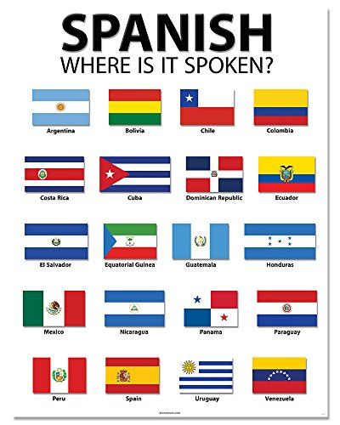
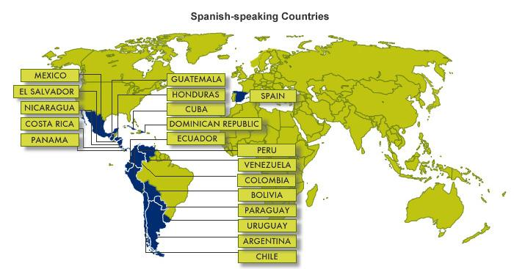
12 Irresistibly Interesting Facts About the Spanish Language
Over 400 million people speak Spanish. ...
There are 21 countries that have Spanish as the official language. ...
Spanish is a Romance language. ...
Spanish has Latin origins. ...
Spanish has two names: Castellano and Español. ...
.
i
Click Here to Return to Main Menu!

